Slide 1
Aircraft Production Technology Assignment Presentation
Zhichao Wang
May, 2023
hansen_wong@sjtu.edu.cn

Slide 2
Outline
Design the Prototype (Seat for the economy class)
Product Construction
BOM
Technical Conditions for Production
Production Process Description
Staff
| SHORT TITLE

Slide 3
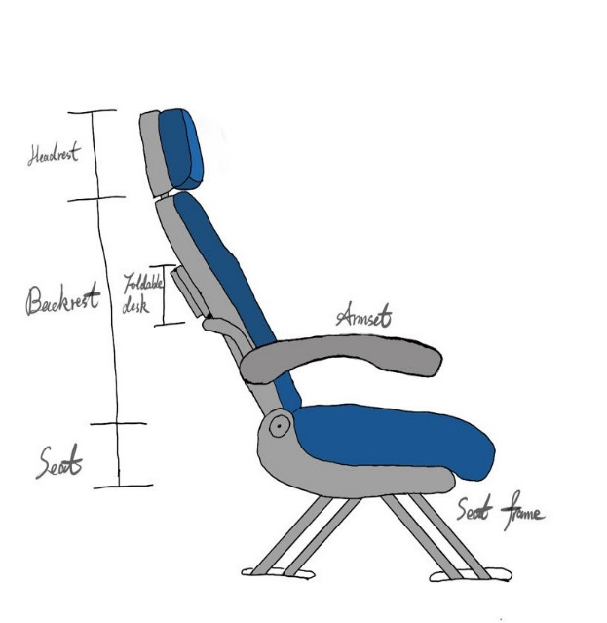
Design the Prototype
Key point:
light, comfortable, and easy to be repaired or refurbished
Characteristics:
a width of 17 inches (43.18 cm)
lightweight composite plastics frame
high-quality polyurethane foam cushions
recline mechanism and adjustable armrests
foldable desks
specially designed button-like connections and locking mechanisms (explained later)
| SHORT TITLE

Slide 4
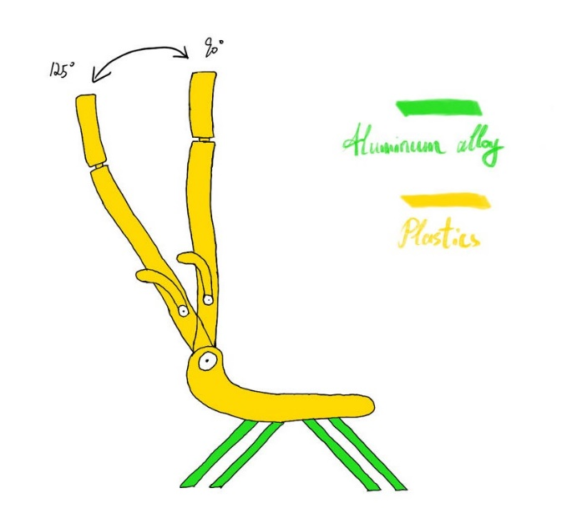
Product Construction
Seat frame

Slide 5
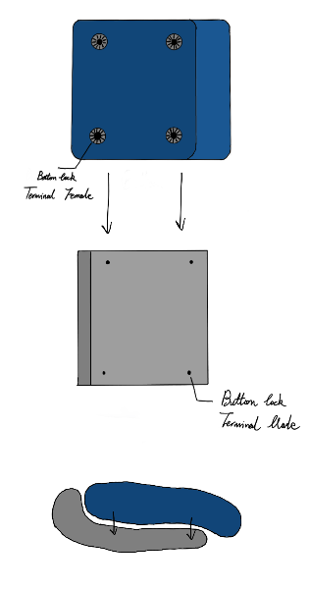
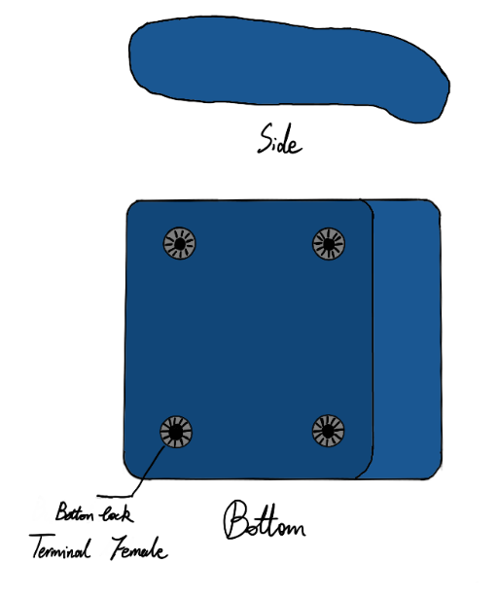
Product Construction
Seat Assembly
(Headrest Assembly and Backrest Assembly are also similar)
(Button-like connections)

Slide 6
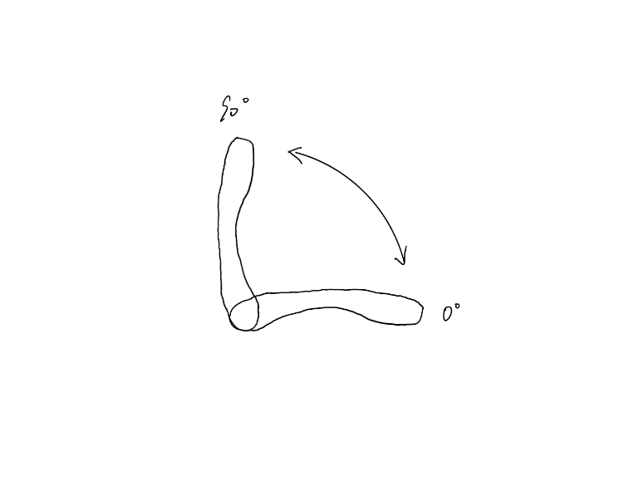
Product Construction
Armrests

Slide 7
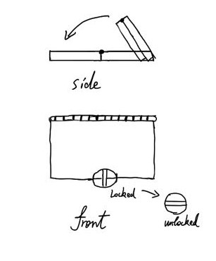
Product Construction
Foldable Desk Assembly

Slide 8
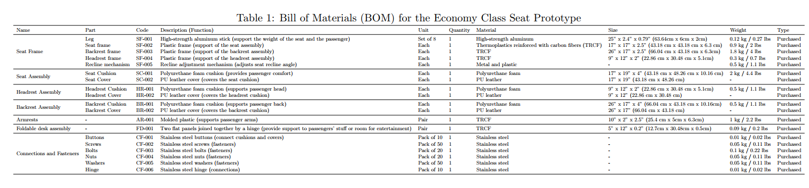
BOM

Slide 9
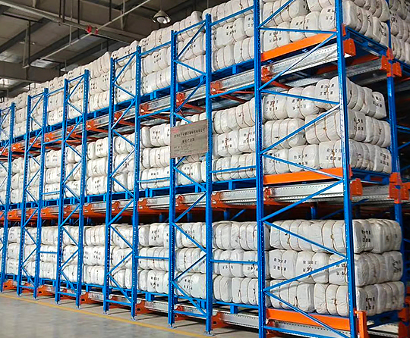
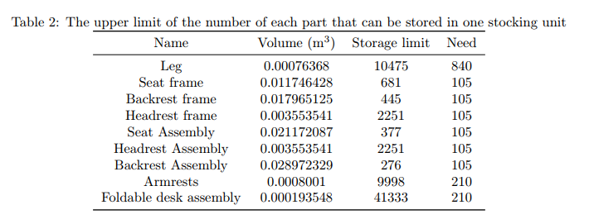
Technical Conditions for Production
Stocking structure
(2m x 2m x 2m per unit)

Slide 10
Technical Conditions for Production
Inventory Size
Suppose we store each part in independent stocking units, also consider one workbench for all the screws and fasteners and three –more stocking units for the assembled seats, the total number of stocking units needed is 12. The inventory size would be the area of the workbench, four three-layer stocking structures and the aisles. Therefore, the inventory size is S_inventory = 12 × 16 = 192 m^2, which includes a very large margin for passage and logistics.

Slide 11
Technical Conditions for Production
Assembly Line
5 assembly stations:
Frame assembly station - Assemble the aluminum legs and plastic frames (SF-001, SF-002, SF-003, SF-004) to form the seat frame structure.
Recline mechanism installation station - Install the recline mechanism (SF-005) onto the seat frame.
Cushion installation station - Install the polyurethane foam cushions (SC-001, HR-001, BR-001) onto the plastic frames.
Armrest and desk assembly station - Assemble the molded plastic armrests (AR-001) and foldable desk assembly (FD-001) onto the seat frame.
Final assembly station - Attach the buttons (CF-001) to connect the cushions and covers, and fasten all components with screws (CF-002), bolts (CF-003), nuts (CF-004), and washers (CF-005) using appropriate tools. Attach the hinges (CF-006) to the foldable desk assembly.

Slide 12
Technical Conditions for Production
Assembly Line
Assuming that each station will require a workspace of at least three times the size of the largest component, the assembly line will require a space of at least 1.9812 × 1.2954 = 2.566 m^2 for each station. Therefore, the total space required for the assembly line will be at least 2:566 × 5 = 12:83m2 for the five stations listed above. Additionally, there should be space for the workers to move around and transport the components from one station to another. Thus, the final assembly line space would be at least 25 m^2.
Quality Check stage
S_QC = 1.5 x S_assembly_line = 37.5 m^2

Slide 13
Technical Conditions for Production
Consumables
Electricity: 297.3 kWh per day
Water: 50 liters/day Lubricants: 2.5 liters/day Office supplies: (5 sheets + 1 ink cartridge + 2 pens) x 2

Slide 14
Technical Conditions for Production
Other facilities:
Forklifts
Toilet
Break room

Slide 15
Technical Conditions for Production
Safety measures:
Training
Personal protective equipment (PPE)
Machine guarding
Material handling equipment
Ergonomics
First aid and emergency
Housekeeping
Regular maintenance and inspection

Slide 16
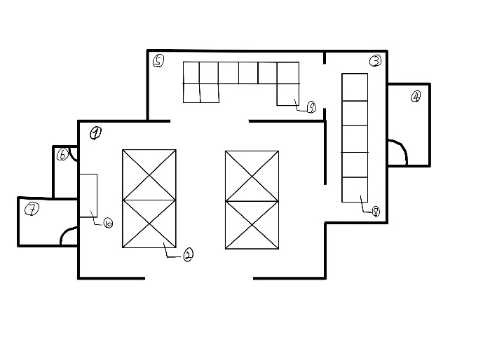
Technical Conditions for Production
1: Inventory.
2: Stocking structure.
3: Assembly room.
4: Employee office (the furniture such as the desks is not shown in the figure).
5: Quality check room.
6: Restroom (the furniture such as the toilet is not shown in the figure).
7: Break room (the furniture such as the sofa is not shown in the figure).
8: Assembly line with 5 stations.
9: Quality check stations with 9 stages.
10: Workbench storing the screws and fasteners.
Overall Factory Site Structure

Slide 17
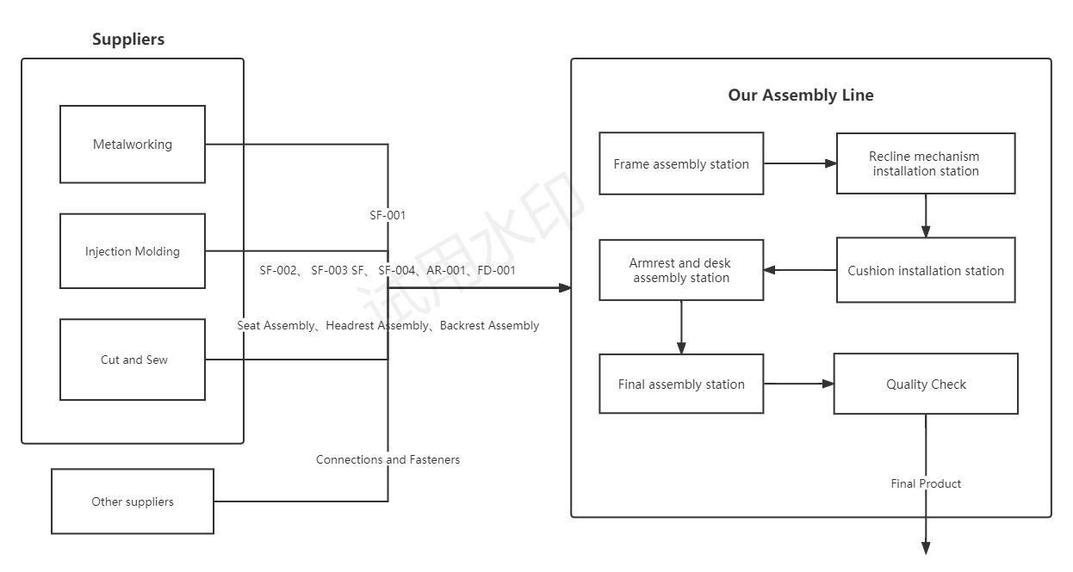
Production Process Description

Slide 18
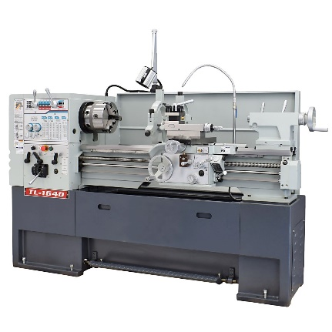
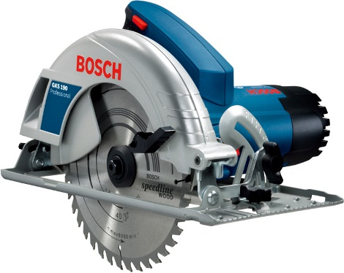
Production Process Description
Metalworking The high-strength aluminum will be cut and shaped into the sticks we need (SF-001) with saw and lathe.

Slide 19
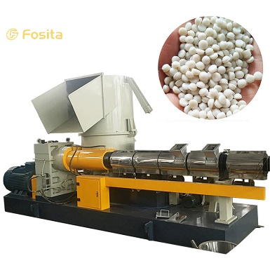
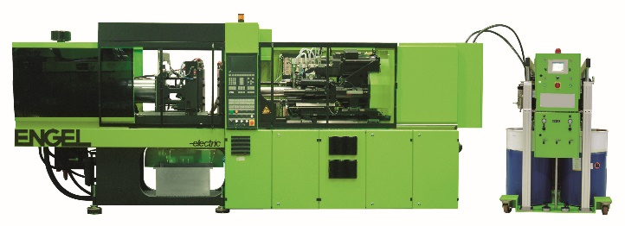
Production Process Description
Injection Molding
The thermoplastics reinforced with carbon fibers (TRCF) will be processed and shaped into the parts we need (SF-002, SF-003, SF-004, AR-001 and FD-001) with pelletizer, injection molding machine and other tools

Slide 20
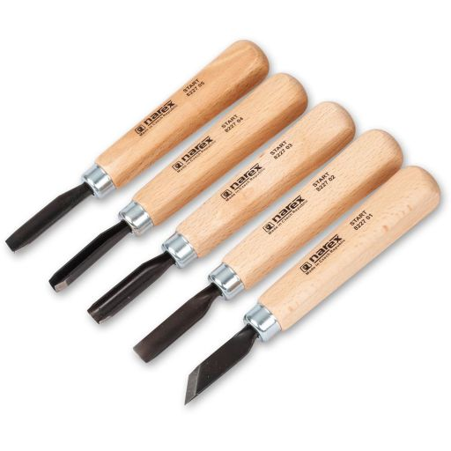
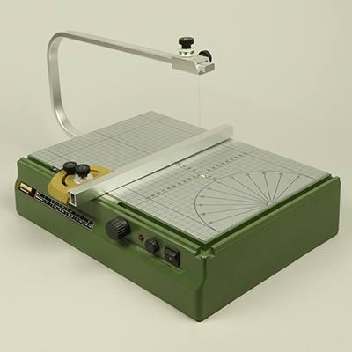
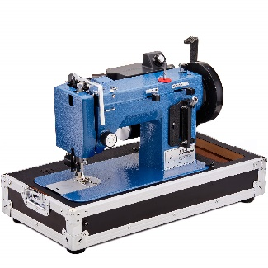
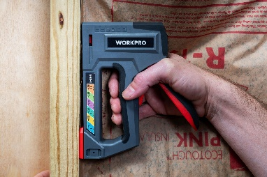
Production Process Description
Cut and Sew
Polyurethane foam and PU leather are shaped to make the seat assembly, backrest assembly and headrest assembly.

Slide 21
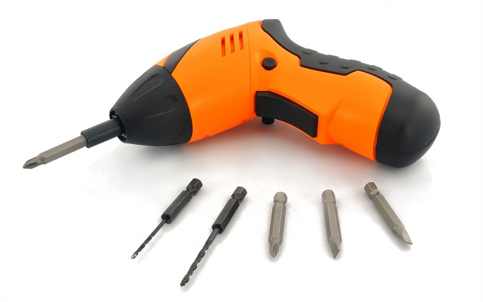
Production Process Description
Installation and Assembly
See the assembly line

Slide 22
Production Process Description
Quality Control
Dimensional check
Weight verification
Frame inspection
Cushion quality check
Recline function and armrests test
Modular component check
Foldable desk inspection
Safety compliance check
Cleaning and maintenance verification

Slide 23
Staff
Workers
Assuming an average workspace of 1.5 m^2 per worker, it can be estimated that the maximum number of workers that can be working at any given time is 16 (25/1.5). Assuming three shifts of work (morning, afternoon, and night), it can be estimated that the total number of workers in a day is 48 (16 x 3). However, the practical number of workers would be less than this, as the number of products needed at this time is only 100

Slide 24
Staff
Employees
Employees are needed to manage the factory and the workers. The number of employees needed is estimated to be 2, including the safety and technical manager and the accountant.

Slide 25
Staff
Guards
Guards are needed to ensure the safety of the factory. The number of guards needed is estimated to be 6, including the three shifts (2 for one shift).

Slide 26
Staff
Estimated time for production
Assuming 16 workers work together at a time and are separated into the assembly line and the quality check, as each worker has a specific task to complete, the assembly line sequence suggests that each station would take around 5-10 minutes to complete. Therefore, the total assembly time for one seat would be approximately 25-50 minutes. Assuming the factory operates 24 hours a day, the production is 28. To completely produce a batch of 100 pieces, it would take 4 days.

